Slide 1
Supporting Domestic Violence Survivors & Their Children: a Deeper Dive into Accessing Services for Families in Need

Slide 2
Objectives
Upon completion of this session, participants will be able to:
Describe strategies for healing-centered support for children and caregivers when IPV is identified
Describe services provided by domestic violence shelters in Alabama

Slide 3
Healing-Centered Support for IPV Survivors
Kimberly Randell, MD, MSc

Slide 4
Healing-Centered Engagement
Holistic, trauma-informed approach
Resilience is universal
Healing occurs within relationships
Healing occurs collectively
Culture
Spirituality
Civic action
What is wrong with you?
What has happened to you?
What is right with you?
Where do you want to go & how may I help you get there?
Ginwright 2018, Miller (in Ginsburg, ed.) 2020

Slide 5
CUES: Healing-Centered Approach for IPV Intervention
Confidentiality
Universal education
Empowerment
Support
Empowers caregivers to
Identify healthy/unhealthy relationship behaviors
Identify impacts of IPV on kids
Access resources for self
Serve as resource for friends & family
Creates a safe environment to discuss IPV

Slide 6
Putting CUES into practice
“Before we get started I want to let you know that I won’t share anything we talk about today outside of the care team here unless you were to tell me about . . .
“I’m giving two of these cards to all of my patients. They talk about relationships and how they may affect our kids. I’m sharing these because relationships can be stressful and sometimes harmful, because our relationships as parents have a real impact on our kids. On the back of the card there are resources you can call or text if you ever need to. And you can always talk to me about things like this, if this is something that is part of your experience, but I want to make sure you know that you can use these resources no matter what you talk to me about. These are also resources that you might want to share with a family member or friend. ”

Slide 7
CUES: - Disclosure is not the goal, but disclosure will happen - Be ready to support

Slide 8
Support After Disclosure
Validation
Warm hand-off to resources
Consider a follow-up appointment

Slide 9
Validation
“It takes a lot of courage to talk about this. Thank you for trusting me with your story.”
“I hear you saying that things are complicated, but you’re worried about how your partner treats you.”
Thank you for sharing.
You’re not alone.
This is
really hard.
No one deserves to be treated this way.

Slide 10
Connect to resources
Warm hand-off is key
Resource list provision alone has minimal impact
Potential resources
Community agency(ies)
Healthcare-based IPV advocacy
National Domestic Violence Helpline
www.thehotline.org
1-800-799-7233
Text START to 88788

Slide 11
Taking steps toward change
Our role is to provide support, share opportunities with a healing-centered, survivor-centered approach
Keep in mind:
Change is a process
Help seeking may escalate risk
Survivors balance risk vs. benefit
Includes consideration for risk to children
Many barriers to help seeking and change

Slide 12
Barriers to Seeking Help
Safety
Fear
Intimidation
Financial concerns
Children
Denial
Isolation
Family/friends
Culture
Self-blame
Shelter
Lack of knowledge

Slide 13
Intersectional inequities may c0mpound barriers
Language injustice
Immigration stressors/xenophobia
Technology inaccessibility
Disability
Racism
Homophobia
Transphobia
Poverty

Slide 14
IPV Power & Control within Pediatric Healthcare Settings
Withholding transportation
Manipulating appointments
Controlling medical decision making
X
Interfering with relationships with healthcare team
Charming or manipulative behavior
Discredit survivors
Stalking
Aligning with providers
Ragavan et al 2020

Slide 15
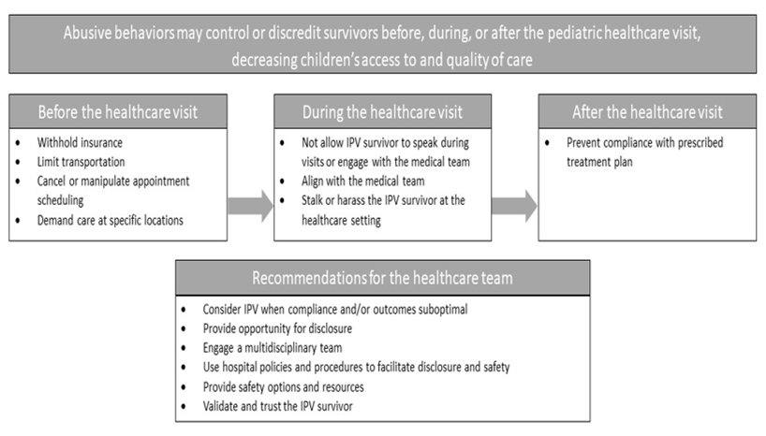
Ragavan et al 2020

Slide 16
Privacy Considerations
Assume a telemedicine visit is not private
01
Ensure communication with the IPV survivor when possible
02
Don’t discuss IPV in front of verbal children and/or multiple adults
03
Consider risks of the electronic health record, including online health portals
04

Slide 17
Risk Mitigation for the Pediatric EHR
Control access
Standard, consistent processes for information release
Mechanisms for limiting access to EHR
Use confidential/sensitive note function
Cautious documentation
Limited documentation
Coded documentation
Discuss risk/benefit with IPV survivors
Education
Healthcare team education commensurate with job role
Randell et al 2021

Slide 18
Child Safety
Assess child safety as part of response to disclosure
Survivor strategies for child safety
Evidence for abuse?
Know your state requirements for mandated reporting
Don’t report without support

Slide 19
Support in the Context of Reporting
Provider level
Inform survivor of CPS report
Offer survivor opportunity to report or assist reporting
Ensure safe EHR documentation
Provide referrals to services & resources
Keep the report focused on child maltreatment
Limit information given to abusive partner
Create a safety plan
Ongoing support for survivor
Clinic/hospital level
Formalized partnerships with IPV agencies
Admission for IPV survivors/children in high lethality situations
IPV training for mandated reporters
Healthcare-based advocacy program
State level
IPV training for CPS workers
Develop non-punitive, alternative CPS options
Support CPS caseworker wellbeing
Dismantle systemic racism within CPS system
Ragavan et al 2022

Slide 20
Domestic Violence Services in Alabama
Taneshia Hannon, MA
Deputy Director, Alabama Coalition Against Domestic Violence

Slide 22
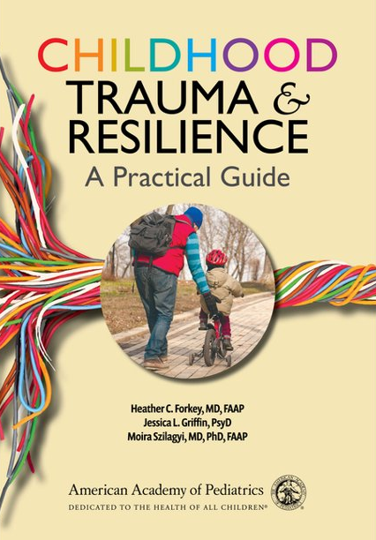
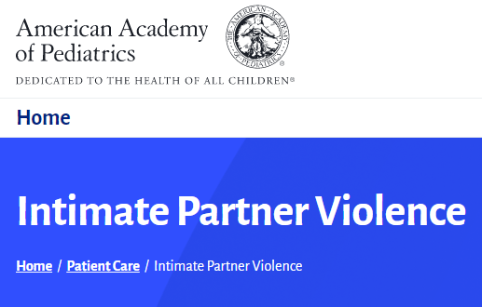
Resources for Providers
American Academy of Pediatrics
IPV & Trauma-Informed Care webpages
Childhood Trauma and Resilience: A Practical Guide
IPV Policy Statement (Thackeray et al, 2010, Pediatrics)
Futures Without Violence
CUES cards, scripts, webinars
Issue briefs – IPV & COVID-19, for child welfare, pediatric healthcare providers, IPV advocates

Slide 23
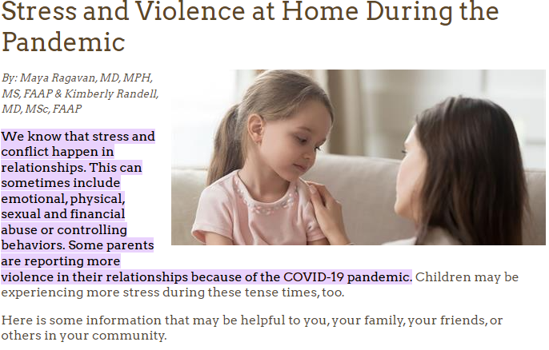
Resources for Caregivers

